Slide 1

`
Impact Localization of CFRP Structure Based on FBG Sensor Network
Y. Z. Sai, X. Zhao, L. Wang, and D. Hau,“Impact Localization of CFRP Structure Based on FBG Sensor Network,” Photonic Sens 10, pp.88–96, March 2020.
Presenter: Ashish Kumar
Student ID: 108998404
Instructor: Prof. Peng-chun Peng

Slide 2
OUTLINE
Proposed work
Introduction
Signal Processing and Localization Algorithm
Experiment and Results
Conclusion

Slide 3
PROPOSED WORK
An impact localization system based on the fiber bragg grating (FBG) sensor network is proposed for impact detection and localization.

Slide 4
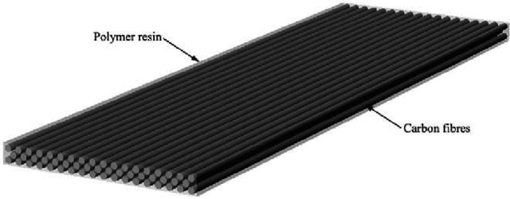
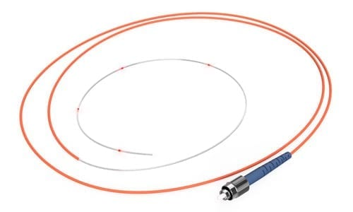
INTRODUCTION
Carbon Fiber Reinforced Polymer (CFRP)
High Strength,
Weight ratio &
Strong resistance to corrosion
Fiber Bragg Grating (FBG) Sensors

Slide 5
FBG sensors and high-speed demodulation - to acquire impact signals on the CFRP plate.
For the impact localization - wavelet packet decomposition is used to obtain different frequency band impact signals.
Energy of the signal - calculated as the characteristic sample.
For high accuracy localization - an extreme learning machine (ELM - only one parameter).

Slide 6
SIGNAL PROCESSING AND LOCALIZATION ALGORITHM
Impact signal (Broadband signal)
Frequency band signal (Different energies)
Distance increase
Energy attenuation different
Distance b/w impact source and sensors
confirmed by
energy change of frequency band signal (LOCALIZATION)
WAVELET PACKET DECOMPOSITION (Extract different band signal & calculate energies)

Slide 7
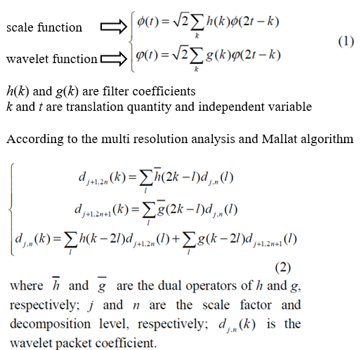
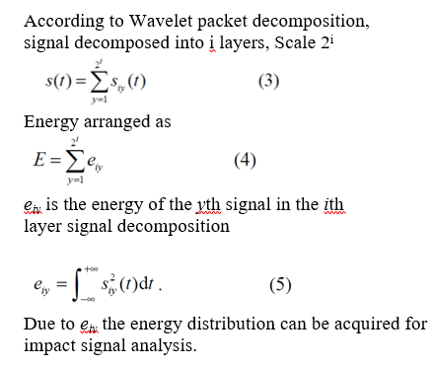

Slide 8
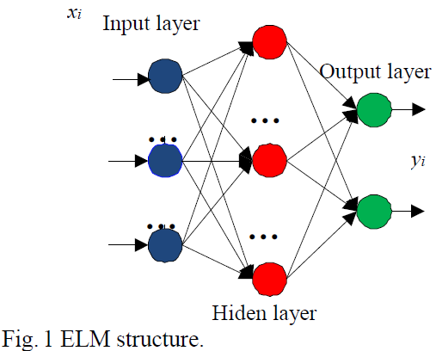

Slide 9
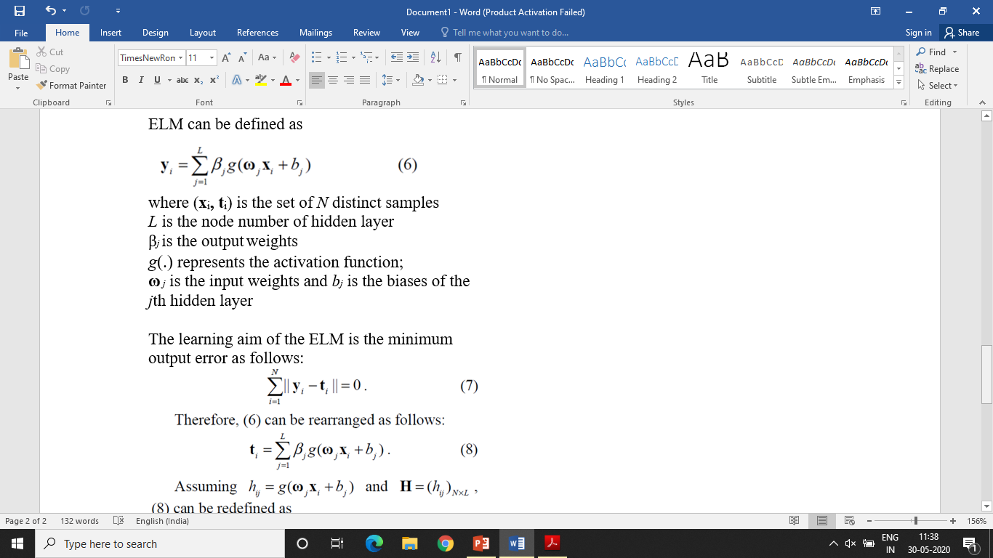
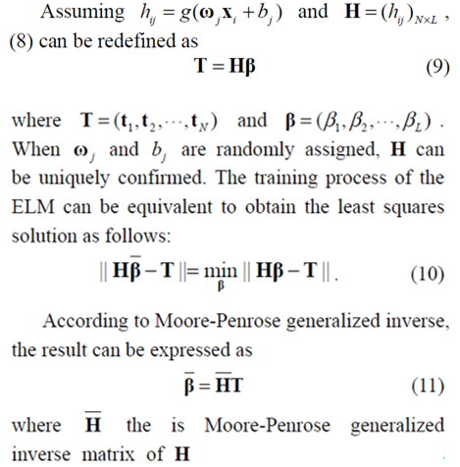

Slide 10
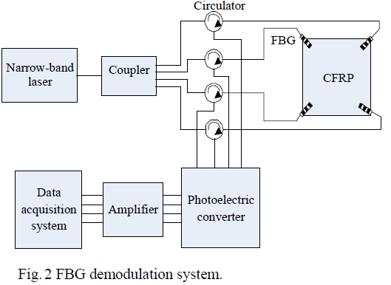
EXPERIMENT
Grating length of the FBG is 10 mm
Narrow-band laser is set as 1565.280 nm
Output power is 10 mW.
Sample frequency of the data acquisition system is 5 MHz.
Santec TSL-510
Reflectance wavelengths of four FBG sensors are 1565.255 nm, 1565.250 nm, 1565.255 nm and 1565.260 nm.

Slide 11
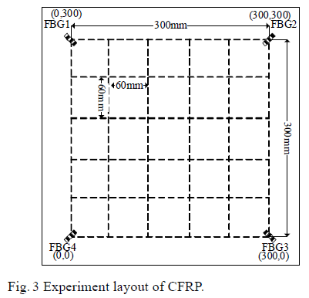
500 mm × 500 mm × 2 mm CFRP plate
Epoxy glue
Impact is simulated by steel ball impact and the impact energy is 0.2 J.

Slide 12
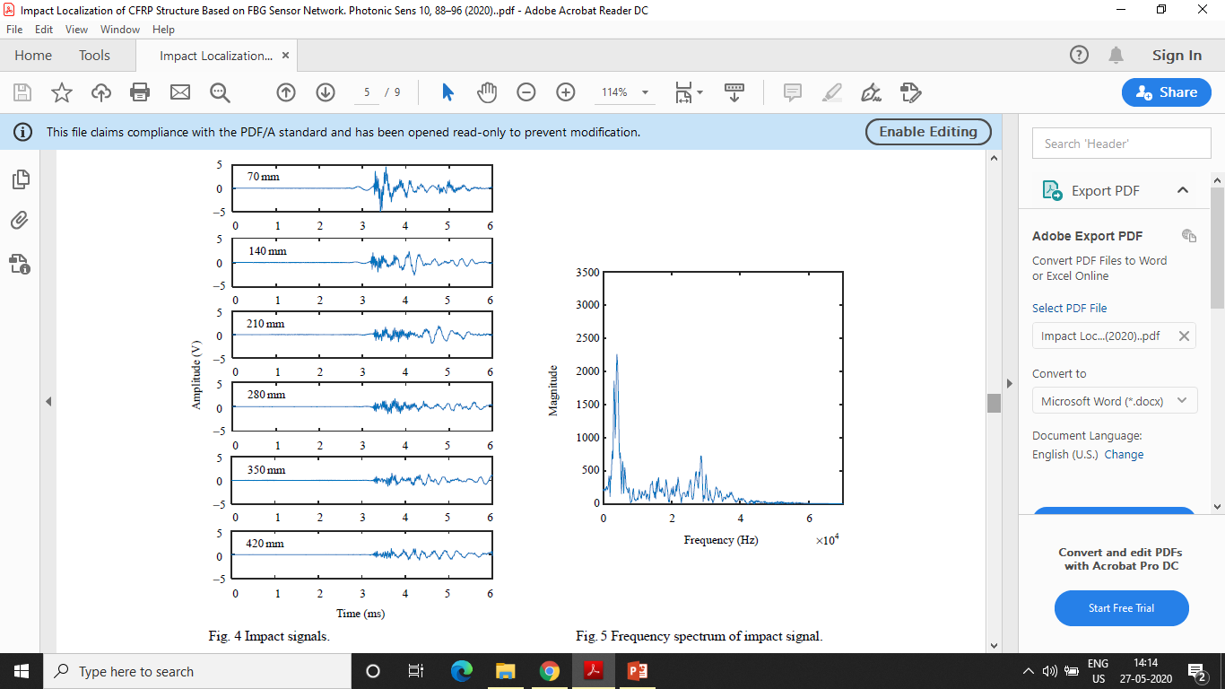
IMPACT LOCALIZATION
↑ Distance between impact source and FBG 3 Amplitude ↓

Slide 13

Frequency range 1Khz - 50Khz NOISE - no accurate relationship

Slide 14
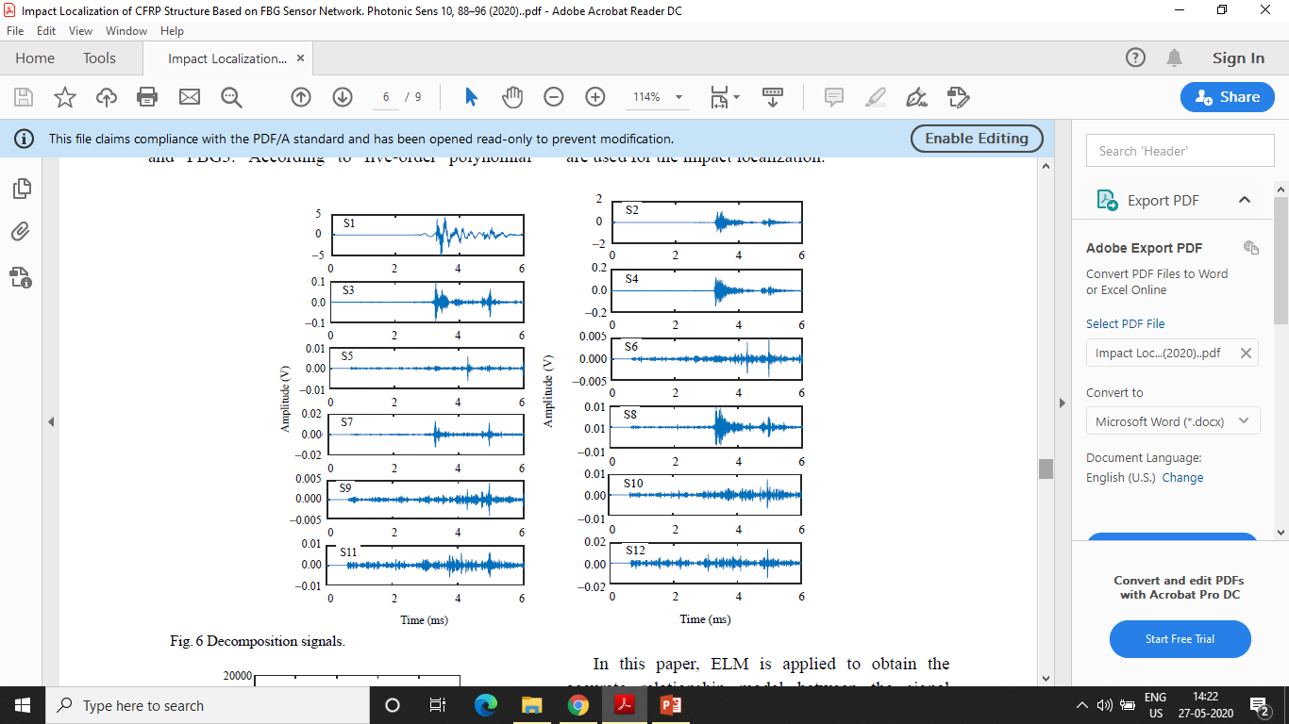
Wavelet packet function sym4
Layer number 6
64 different frequency band signals
Amplitude S1, S2, S3, S4 more then 0.05V

Slide 15
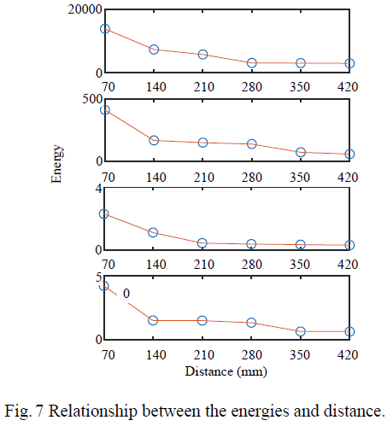
Five order polynomial fitting

Slide 16
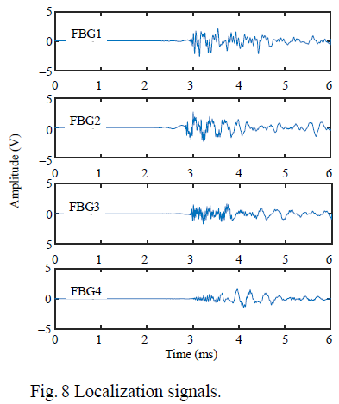
Verifying ELM Model
(190mm,250mm)

Slide 17
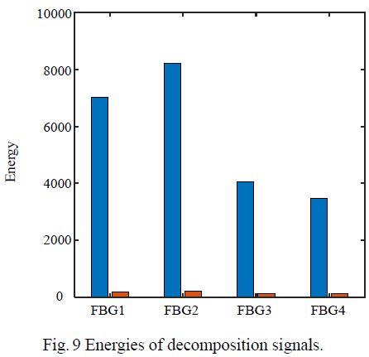

Slide 18
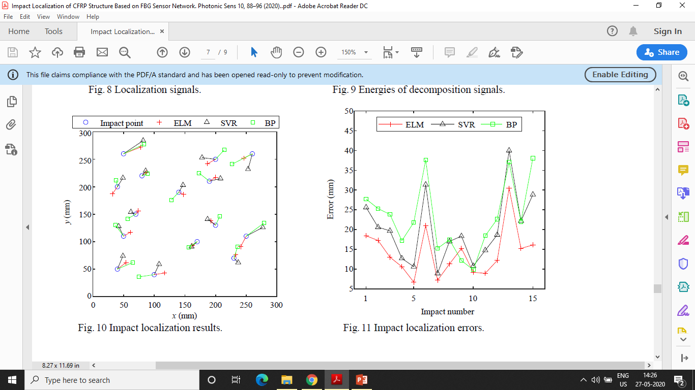

Slide 20
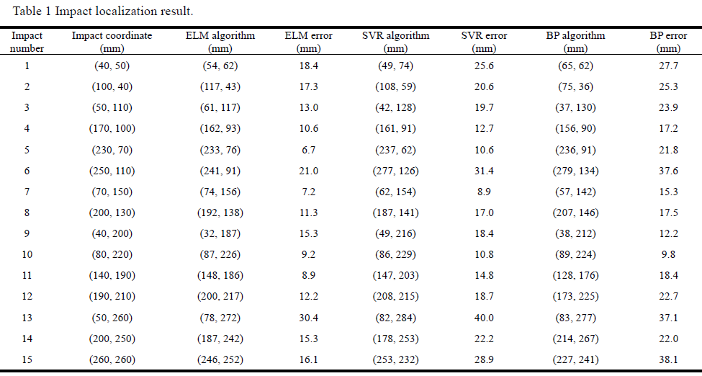

Slide 21
CONCLUSION
The maximum, minimum and average localization error localization error are 30.4 mm, 6.7 mm and 14.2mm respectively.
The training time is 0.7 s (better than 1.6 s and 3.2 s).
ELM has better results and less training time consumption with only one adjusted parameter.
The impact localization system and algorithm proposed provide important means and method for the high accuracy impact detection of the CFRP structure.

Slide 22
Thank You!!

